Slide 1
The Heartbeat of Inverclyde
What to coach into our players
Game Knowledge?
Can they take someone on or defend a 1v1?
Do they have a good level of technical ability?
Can they control and take a ball under pressure?
Are they aggressive/determined to be on the ball/win it back?

Slide 2


What we are looking for in a child to have a good Level of Technical Ability?
Controlling a ball/ball mastery
Moving the ball with first touch
Being able to perform skills in 1v1’s
Passing – Zipping the ball into team mates with various areas of the foot/weaker foot. No weak passes

Slide 3
Can they control and take a ball under pressure?
Moving the ball away from opponent
Using their body against opponent to protect the ball
Taking the ball under pressure with various parts of the body?

Slide 4
Can they take someone on/defend a 1v1?
Positive/willing to run at a player with the ball?
Willing to try a skill in a 1v1 situation?
Knowing when/what areas of the pitch to take someone on?
Knowing when to stand up and when to tackle (Watch the ball not the player) ?
Aggressive when tackling/using there body in the tackle also?

Slide 5
Are they aggressive/determined to be on the ball/win it back?
Desire to want to be on the ball as much as possible? Especially when the team is loosing.
Getting back on the ball after losing it?
First thought after losing the ball is how do I get it back - not feeling sorry for themselves and flapping there arms?
Being brave to take the ball in tight areas?

Slide 6
Game Knowledge
Width
Depth
Support
Penetration
7 aside Patterns of play – playing out from the keeper
What if?
Final what if?
11 aside Patterns of play in a 4-4-2 – playing out from the keeper
Patterns of play in 4-4-2
11 aside Patterns of play in a 4-3-3

Slide 7
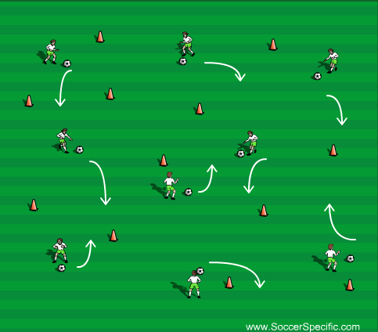
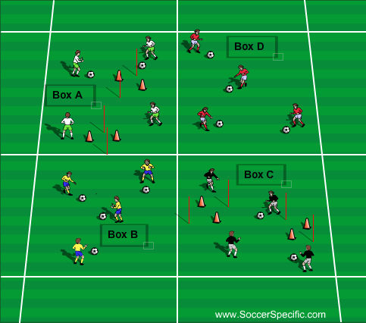
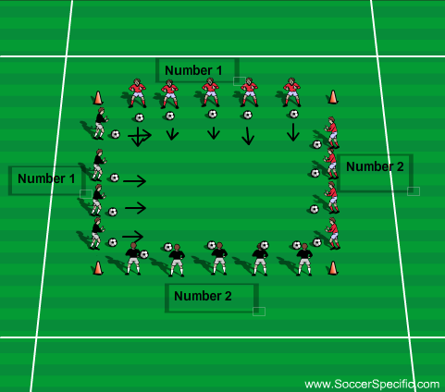
Controlling a ball/Ball Mastery
Kids all have a ball, working on various different skills. Add cones in to run at and perform skill.
4 Different Boxes. All boxes are performing the same skill a coach shouts. Boxes B & D are just driving towards each other and performing the skill. Boxes A & C are passing it to partner and taking a touch with certain area of the foot to shift it towards game and perform skill through the gate and beat a pole.
Each player on the edge of the square is either number 1 or 2. Coach will say was skill or which way the players have to dribble with the ball across the square. There will be two lots of players going at the same time to make it busy and encourage players to play with their head up.

Slide 8
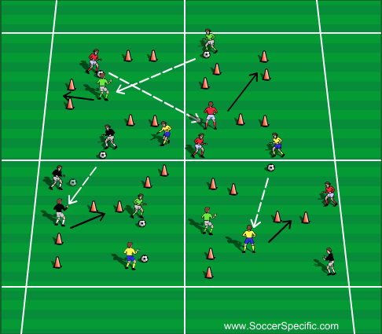
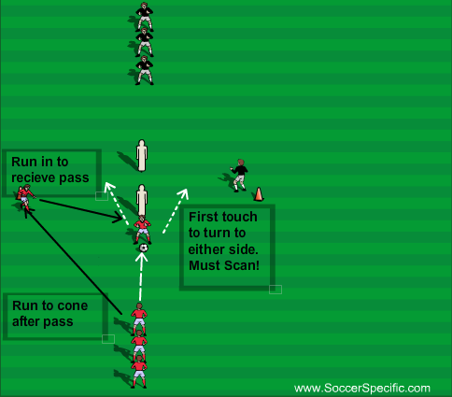
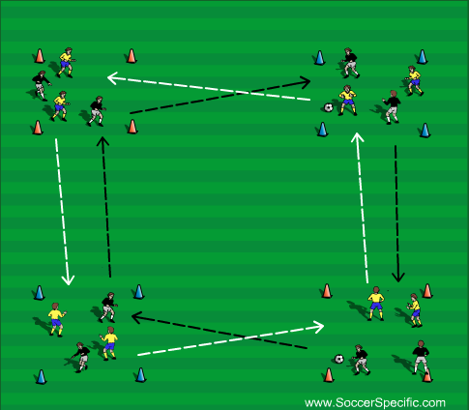
Moving the ball with First Touch
2/3 or 4 boxes with even teams in each box. Gates also set out. All players have to do is pass the ball to a team mate in different box. Player receiving must take a touch towards a gate (not directly in front of them) and dribble through it.
Progression get player who passed the ball to press player receiving the ball or to go block gate and they have to quickly change which way they move the ball.
Add time limit to how many gates they can get through also.
Two teams working on turning on the ball with a first touch. At the start they can turn in any direction they want. After a few minutes they must not turn the same way as (Black/Red players). Player who passes forward runs to side cone then when its their turn times run to get on the ball and turn.
Progression player who is at the side stands behind the player and moves to one side as they player who is turning takes it. No Tackling just applying pressure for other player.
Add in goals for players to finish to make it more game like.
Ajax box with two teams in each box going in opposite direction from each other. Players must scan when taking the ball to get first touch away from other players in the box.
Progression add a one two in the box before playing to other box.
Add in a player standing behind player receiving ball for more pressure.

Slide 9
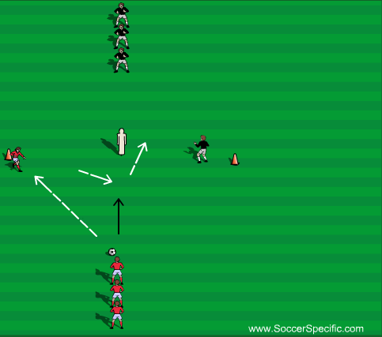
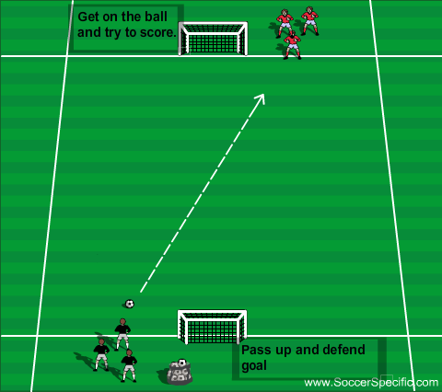
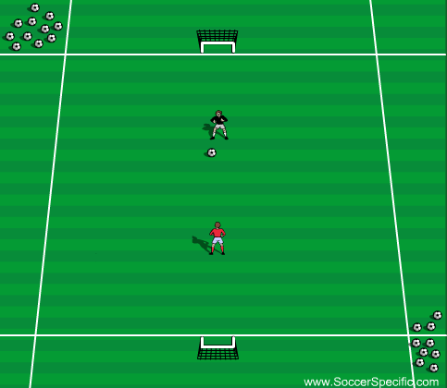
Being able to perform skills in 1v1’s
Simple pass with a lay off. Player steps on and beats the cone/pole. While other team do the same. Encourage children to perform any skill they with and never to perform the same twice! Player beating the cone/pole just goes to the side to lay off next and player laying off joins opposite queue.
Progression player who lays off sprints into middle to become a passive defender (show one way to force player to decide quick which direction to go)
Make defender fully live to win ball after a while/add goals to finish into/make it a race to speed the game up.
Player Fires the pass up to opposite player the its becomes a 1v1 if players loses the ball then the other player goes and try's to score. Game continues to play until one person scores or ball goes out several times. If ball does go out then fire a new one into to continue the flow. If it stays 0-0 for over a minute then stop the game and new pair go.
Always have players ready to play as soon as someone scores – keeps the intensity of the session flowing.
Simple 1v1. if you score you go and get another ball and continue to run at the player.
Players work for 1-2mins.

Slide 10
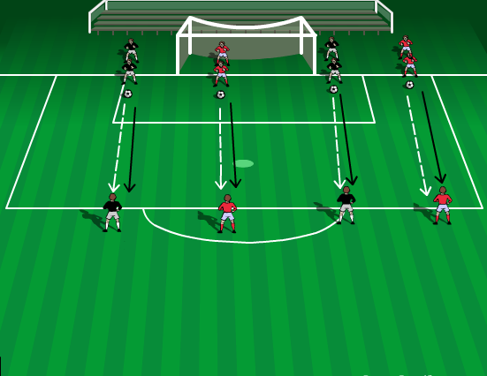
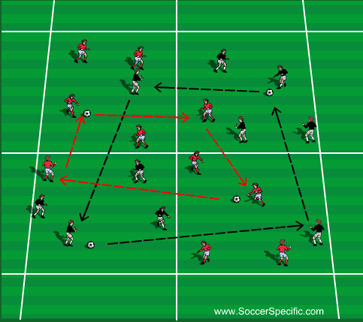
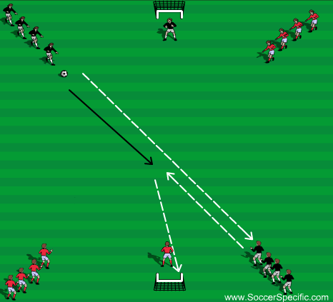
Passing – Zipping the ball into team mates with various areas of the foot/weaker foot.
Players fire passes into each other and follow there pass.
Change to use various parts of the foot. Focus on the players firing the pass at each other, no weak passes.
4 boxes. Each team will have a player in an opposite teams box. All the teams are doing are fizzing the ball to team mate in the box.
Progression – Add in one twos all the way round. Continue to focus on fizzing the ball and team mates.
Shooting drill but the emphasis is on the pass up to the player and the pass to lay it off. Must be fizzed up to the player who has to cushion the lay off for player to strike first time.

Slide 11
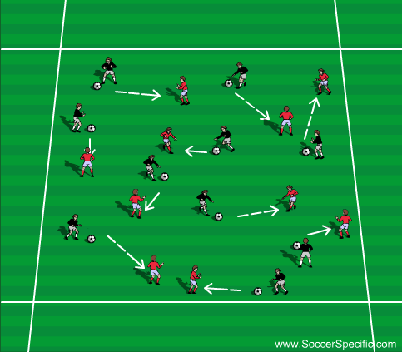
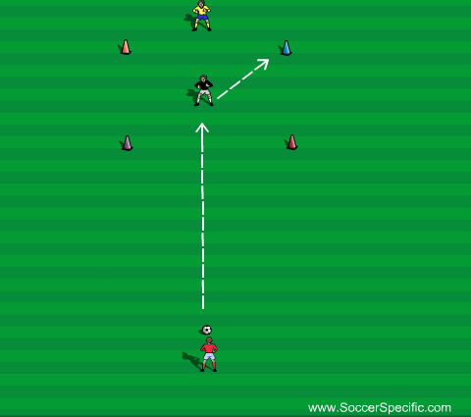
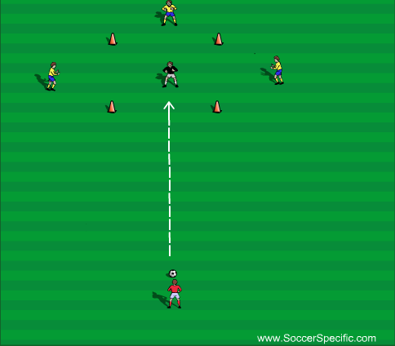
Moving the ball away from an opponent
Players are in pairs with opposite team. Pass the ball into them and press them. (no tackling) player receiving the ball must move it away from player and into space with first touch.
Players passes to team mate shouts colour and player must take first touch and round the cone.
Progression – Defender (Yellow) comes and stands to a side of the player as the ball is being passed to them player must scan and take the ball away in the other direction.
Player passed to team mate in box as the ball is close to the player receiving it, one of the defenders (Yellow) will run into the box player receiving it must take a touch away from oncoming defender.

Slide 12
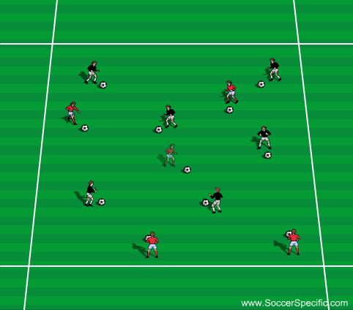
Using body to protect the ball.
King of the ring, players try and protect there ball while kicking other players footballs out the square. If put out much perform a skill at the side a certain amount of times – each player has three life's.
Progression – Make one team have a football each and pair them off with opposite player without the ball, must protect and keep the ball off opposite player they where paired off with.
Final Progression – one team has footballs again this time they aren’t paired off they can tackle anyone.

Slide 13
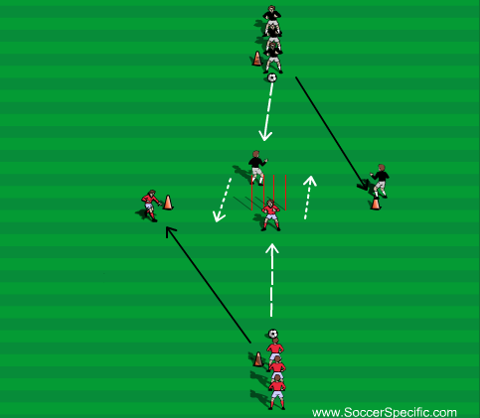
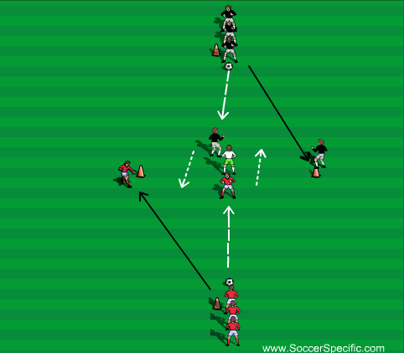
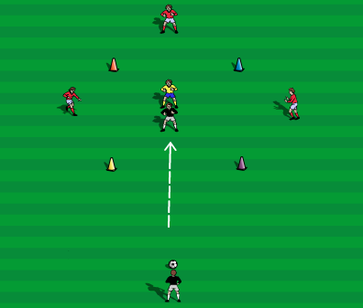
Taking the ball under pressure with various parts of the body.
Players pass ball into team mate in front of them and turn with the ball and join opposite queue, player who passes goes to side cone and runs in when its there turn to receive pass.
Progression – remove poles and tell the two players turning they aren’t allowed to turn in same direction and aren’t allowed to tell each other which direction they are turning before hand.
Can chip/throw ball into player in the middle working different parts of body.
Similar to the first drill, but this time put a defender in who can tackle one of the players turning.
Can chip/throw ball into player in the middle working different parts of the body.
Pass, chip or drive ball into player and shouting colour. Must touch towards.
Progression – One wall player runs in at a time and player must take touch away from that player and defender behind them.
Progression – Make defender behind them live so that player had to use body to protect ball .

Slide 14
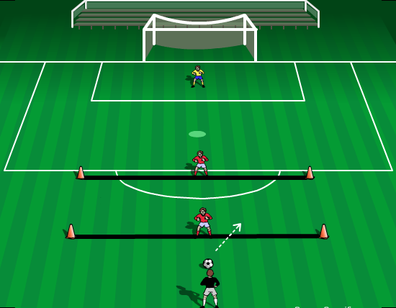
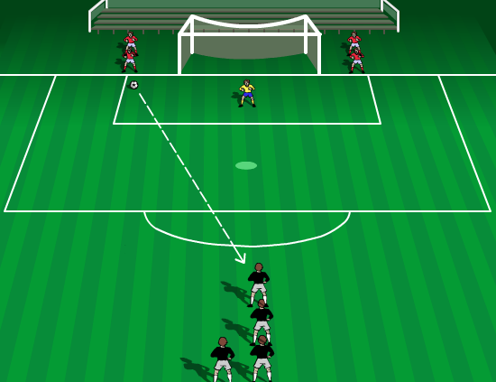
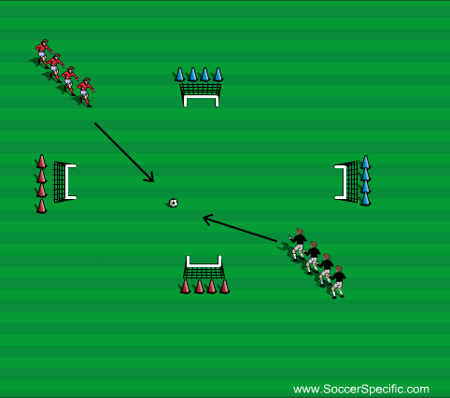
Positive/willing to run at a player with the ball?
1v1 situations. Red players can only move and stay on black line. Black player runs and try's to be each player then have a shot.
Progression – 1st defender can track back if the player beats them. But can only track back to the second line not past it.
Again 1v1 situations. Defender passes the ball up and comes up to press/win the ball.
Encourage defender to press quick and attacker to drive at defender and do any skill they want to beat the player.
4 goals, coach plays ball in and first person for each team comes out and try’s to score in there colour of goal.
Progression – put gates out inform of each goal and to score you must dribble through them first to score.

Slide 15
Knowing when/what areas of the pitch to take someone on?
Speak to them during games/training
Encourage them to be positive and take people and let them make the mistake.
Put them in situations to make the mistake and learn themselves before we coach them.

Slide 16
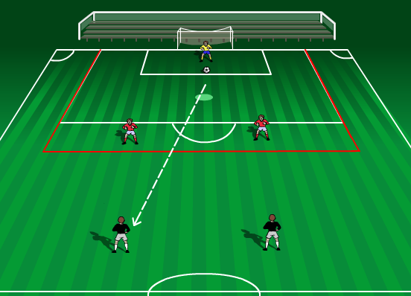
Knowing when to stand up and when to tackle (Watch the ball not the player) ?
Drills like this can encourage players to look for triggers in opposite players. Can be 1v1,2v2,3v3 right the way through to 11v11.
Use the extended red box as a danger zone. If opposition players get in that zone we need to press and win the ball back quickly.
Teach the players to look for triggers. i.e. when a player has lifted his/her head/chest and body are up he/she is more likely to shoot or play pass so we need to look to go tackle/block especially in this red danger zone.
Or if a player rolls the ball out his feet most likely he/she is going to shoot so we need to be out close enough to block as well be able to match players movement if they dribble.

Slide 17
Aggressive when tackling/using there body in the tackle also?
Put the children in situations where they have to use there body. King of the ring etc.
Talk to them while doing it about being determined to keep the ball and not loose it.

Slide 18
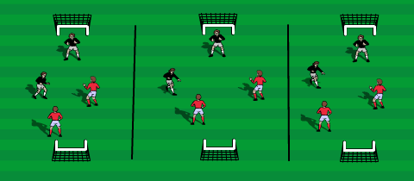
Are they aggressive/determined to be on the ball/win it back?
Use small sided games to created a determined/aggressive mind set. The players are constantly being tackled, loosing goals and been asked to take the ball in tight areas.
Create scenarios for the teams – one team starts the game 4 nil down and must get it back in 10mins. Can be used on a 5s/7s or 11s pitch again to create this mind-set.
Encourage children to win the ball back as quick as they can once they loose it, make a competition out of it see who does it the quickest.
Remind the kids continually to keep working until the final whistle.

Slide 19
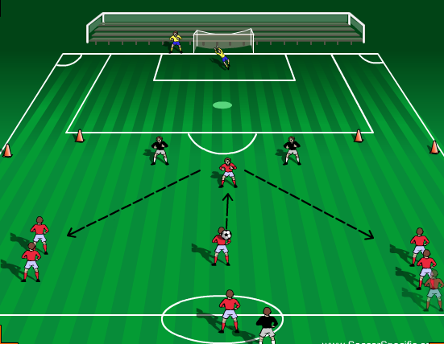
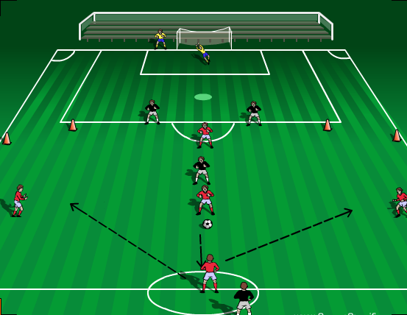
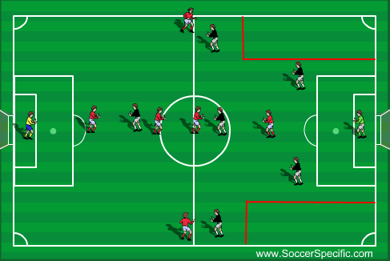
Width
Player in the middle plays to striker who plays the ball Left or Right and each Left and Right mid steps out to create a 3v2 against the 2 Black defenders.
Looking for attacking to team to get as much width as they possibly can. Attacking team will get an extra point every time they get through the gates at either side of the pitch with the ball they get an extra point.
If Defending team will the ball then they play to Striker who turns and shoots into the 7s goal.
Progression
Same drill expect this time it’s a pass back from midfield as if there isn’t a pass on forward. For the deep lying midfielder to play a pass out wide to start attack.
Extra defender in midfielder for the black team. Again if they will they play to the Striker who turns and shoots.
Normal game but the condition is that the black team cannot tackle the red team when they have the ball in the red end zones at the side. Also the Black team cannot be in there when they have possession of the ball either.
Progression;
Black team are allowed in to tackle in the Red end zone.
Final Progression;
No end zone at all, just a normal game.

Slide 20
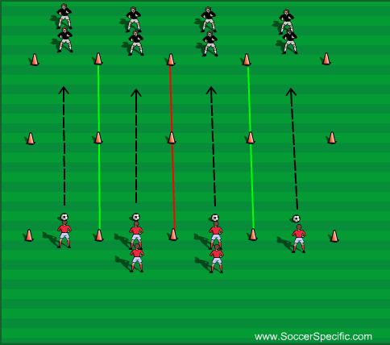
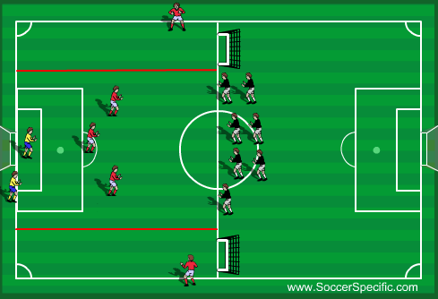
Depth
Simple 1v1s to start off with. Red defenders look to press high win the ball and show Black (Attacking team) out the side of the channel. Attackers looking to get past defender and
Progression 2v2;
Move the cones on the green line away. Talking about nearest man to engage the ball while other drops off slightly.
Progression 4v4;
3 set up as a back 3 and one sits in front like a sitting midfielder again looking to defend the line and pushing the attackers wide with the ball.
Progression 5v4 in attackers favour.
4v3
To start 4 attackers will come out and look to attack the goal. 3 defenders will stop attackers scoring if the defenders will the ball they then get a FREE dribble into the end zone and go and score into the small goals.
As this happens then the next 4 attackers will go and the defender scoring in the goal has to recover.
Progression;
Attackers pass the ball left/right and if it’s passed left/right then the opposite recovering midfielders comes in to help defend in front of the back 3.

Slide 21
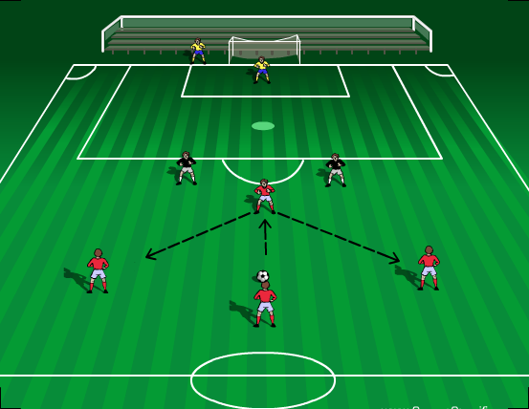
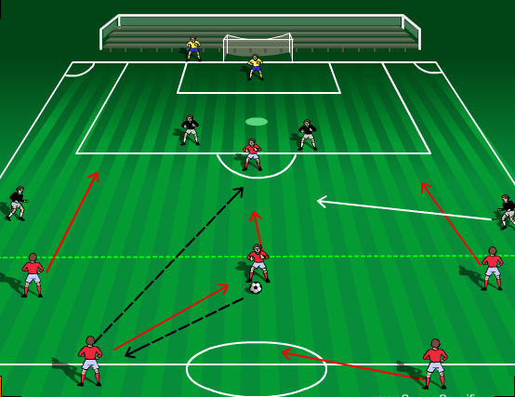
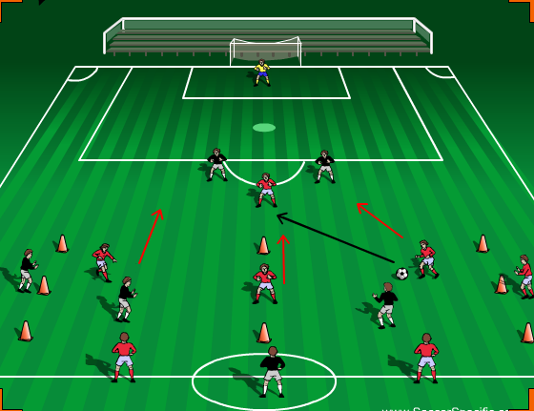
Support
Middle player plays the ball out to striker who pops the ball left or right and both left and right mid step out and attack to create a 3v2.
Looking for at least one play to sit a bit deeper to offer an option behind the ball as well as going forward.
This time instead of playing forward they play the ball back as if they are under pressure. Play to CB who plays to ST then the 3 midfielders break the midfield line (Green line) and flood forward to support the striker. 4v3
Black team have a recovering defender if it’s played to RCB then LM comes out for the black team and vice versa if it’s played to LCB.
3v2 Possession box with wall players once red team make 3 passes then they look to hit striker and then the 3 players in the box join the attack with one recovering defender from the box.
Progression;
2 recovering Defenders from the box.

Slide 22
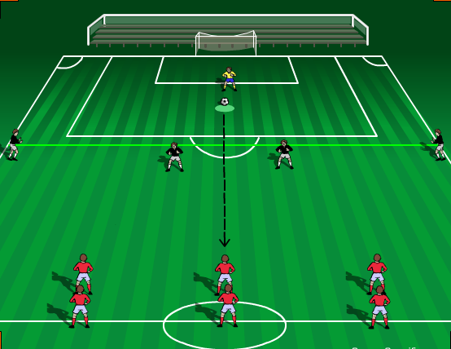
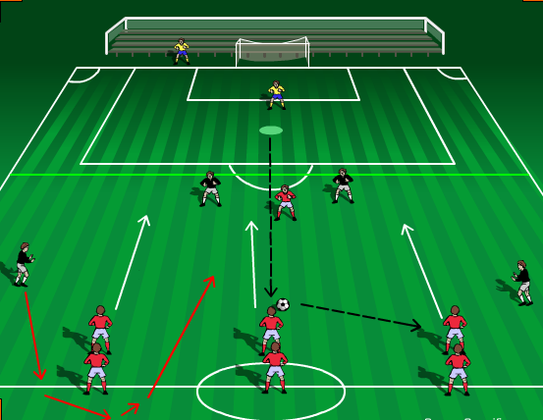
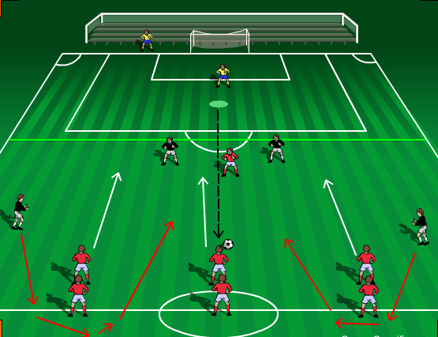
Penetration
Goal Keeper plays the ball up to attackers (Red) and they step out with the ball to play a 3v2 against the two defenders (Black)
Defenders are not allowed into the end zone (Green line) until ball is passed into zone. Attackers are looking to get the ball into that area for team mate to step onto and get a shot away. Two defenders at the side rotate with the defenders after each attack.
Progression
This time a striker plays in between the two defenders to occupy them. The keeper plays the centre attacking player who has to play the ball left/right to the other attacker. If plays left then the right defenders comes in as a recovering midfielder or if plays right then left defender is in. 4v3
Progression
This time attacker doesn’t play left/right just goes and plays when receives ball and both recovering midfielders are in. 4v4

Slide 23
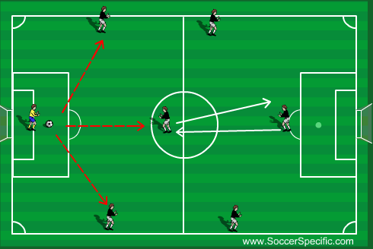
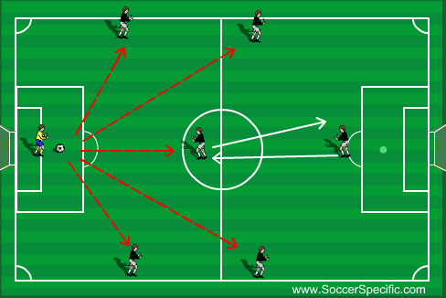
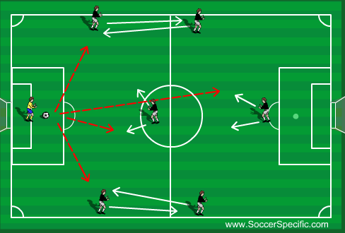
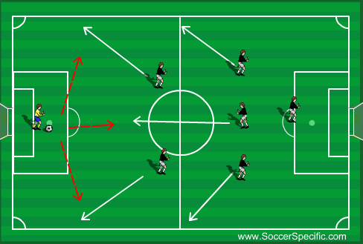
7 aside – Playing out from the keeper.
Key: Red broken line = Ball path. White line/arrow = Player movement.
Option 1
CB’s Split and go touchline wide.
LM/RM go touchline wide and high up the park (just over half way line) must stay in line with CM.
CM goes high up park also
ST stretches the game to the edge of opposition’s box.
GK’s Options – RCB, LCB and CM
What If the other team locks on/marks players receiving ball.
CM and ST look to rotate places
If both CM and ST are still marked when doing the rotation then LM or RM can look to step into the CM position. CM/ST must then take LM/RMs place to keep the balance in the team.
Order of sequence for rotations if other team has locked on; CM and ST rotate then RM and ST (in Centre mid role) and finally RM and LM Rotate then repeat until opportunity arises to play out.
What if other team starts second guessing the rotations of players?
CB’s Split and go touchline wide.
LM/RM go touchline wide and high up the park (just over half way line) must stay in line with CM.
CM goes high up park also
ST stretches the game to the edge of opposition’s box.
Next part of the rotations
LM/RM swap places with CB’s
CM looks to drop off to the side left or right
ST drops the opposite way of CM to get on the ball
GK’s options – LM, RM, CM and ST. If the opportunity is there GK can play to CB’s who are in LM/RM positions.
What if team second guesses both rotations?
Team will go narrow and high up the park as if keeper is kicking long.
CB’s will then split off and drop touchline wide
LM/RM will split touchline wide towards the half way line
CM will drop in between CB’s to get on the ball
ST will stay high
From this team will look to do one of the rotations.
Example – When high and narrow instead of the CB’s dropping touchline wide for GK then the LM/RM would do that and CB’s would take their place. (Part B)

Slide 24
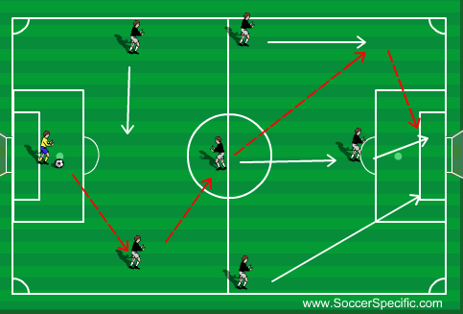
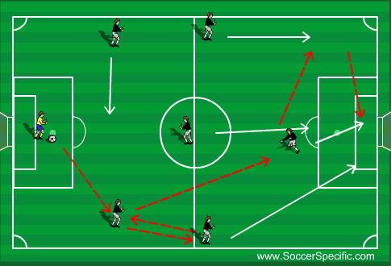
7 aside – Patterns of Play. Option 1
(Trigger for CB’s to split is GK dropping ball at his/her feet)
GK plays to RCB, CM drops to get on the ball and receives on the half turn. Then plays diagonal pass for LM to step onto and deliver a cross. ST makes front post run, RM gets in at the back post and CM arrives at the edge of the box to pick up any scraps and the two CB’s step up in relation to the ball and narrow up in case of counter attack.
** When working patterns of play at training work both sides left and right!
(Trigger for CB’s to split is GK dropping ball at his/her feet)
GK plays to RCB, RM goes high and drops shout to play a bounce pass with RCB as this happens ST drops into the hole for RCB to play pass to and take ball opens up and plays to LM who steps on and delivers cross. Once ST has played ball wide they spin and make run to front post, CM arrives at the edge of the box and RM comes in at the back post. Two CB’s narrow up and step up the pitch in relation to the ball.
** When working patterns of play at training work both sides left and right!

Slide 25
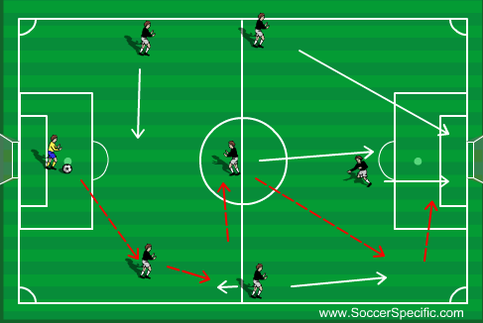
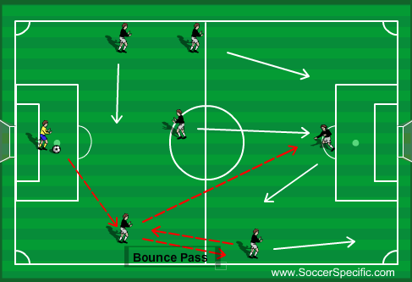
7 aside – Patterns of play, Option 1. What if?
(Trigger for CB’s to split is GK dropping ball at his/her feet)
GK plays to RCB, as that is happening RM is making a run up the line to check off and get the ball short from RCB. RM then plays ball into CM. RM then spins and runs back up the line for CM to play pass into his path for a cross.
As this is happening CB’s narrow up and set up the pitch in relation to the ball.
LM runs from touchline wide into the box (diagonal run – harder to pick up for a marker)
ST makes run to front post
CM arrives at the edge of the box for cut back
** When working patterns of play at training work both sides left and right!
(Trigger for CB’s to split is GK dropping ball at his/her feet)
GK plays to RCB, RM has made a run up the line then checked off short to receive a pass from RCB. RM bounces the ball back to RCB who the plays a pass right through the middle for CM to step onto and finish.
For this to work as the bounce pass is happening between the RCB & RM the ST needs to drop short towards the ball taking a defender with him to allow the other teams CBs to split to create the space for the late run through the middle from CM.
If CM gets the ball and the other teams CB is there to stop route to goal then LM & RM are stepping on so CM can look to slip a pass into them to go and finish.
** When working patterns of play at training work both sides left and right!

Slide 26
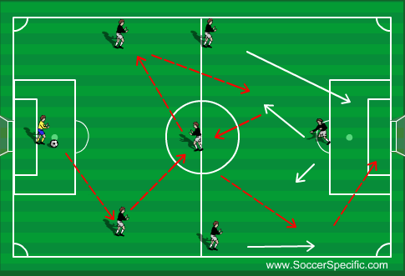
7 aside- Pattern of play, option 1. Final What if?
(Trigger for CB’s to split is GK dropping ball at his/her feet)
GK will play to RCB, CM shuffles over to receive pass from RCB and plays to LCB. ST drops short towards LCB and receives pass. From there ST plays to CM who plays pass into RMs pass who the Crosses.
AS this is happening ST & CM MUST move in relation with the ball to drag marker away.
LM & RM will stay high to keep markers away
If pass isn’t on to CM at start then look to play to LM/RM to bounce into ST to continue pattern of play.
** When working patterns of play at training work both sides left and right!

Slide 27
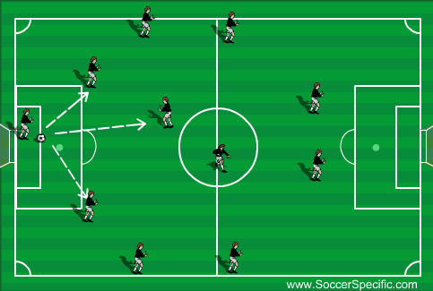
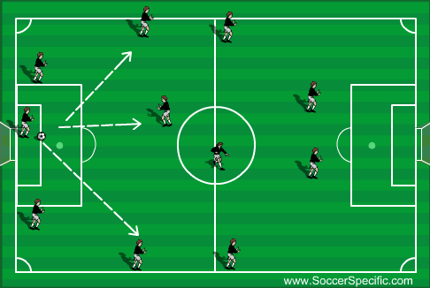
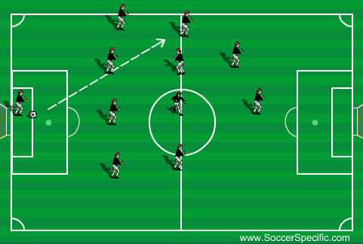
11 aside – Pattern of play in a 4-4-2 (or any shape with a back 4). Playing out from the Keeper
(Trigger for CB’s to split is GK dropping ball at his/her feet)
CB’s Split wide and look to hit either CB. If not midfield is high with CM dropping in to get on the ball.
** When working patterns of play at training work both sides left and right!
(Trigger for CB’s to split is GK dropping ball at his/her feet)
Very similar to the first one except CB’s Split and drop almost in line with 6 yard box and keeper plays to RB/LB or CM
** When working patterns of play at training work both sides left and right!
(Trigger for CB’s to split is GK dropping ball at his/her feet)
LAST RESORT!
Play the ball high and wild but team must narrow up to win second ball.

Slide 28
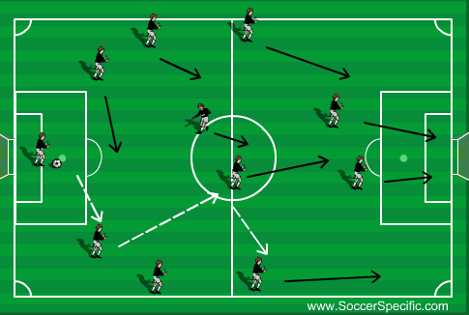
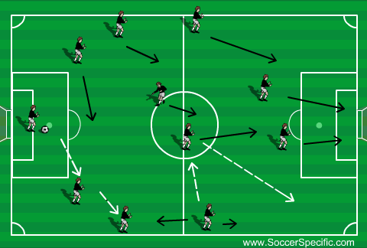
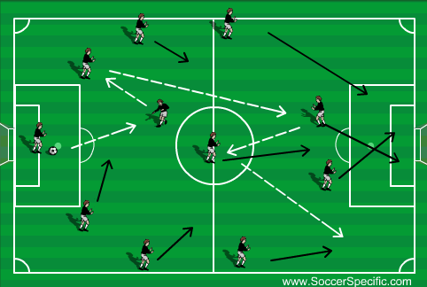
11 aside – Pattern of play in a 4-4-2.
(Trigger for CB’s to split is GK dropping ball at his/her feet)
CB’s Split wide and GK looks to pass to CB, CB then plays to CM to plays wide to RM who can drive and have a 1v1 or pass to ST to get it back up the line and then look to cross.
** When working patterns of play at training work both sides left and right!
(Trigger for CB’s to split is GK dropping ball at his/her feet)
CB’s Split, GK play to CB who plays to RB who looks to play to RM, as the ball goes to RB the RM goes high first and pushes of his marker to come short to receive ball from RB. RB then plays to CM who returns up the line for RM to get onto and cross.
** When working patterns of play at training work both sides left and right!
(Trigger for CB’s to split is GK dropping ball at his/her feet)
CBs Split and CM drops in and gets the ball (if CM can turn and drive then they should) CM bounces to CB if they have a marker tight to them. As this happens one ST drops shorter to receive the ball from CB, ST then bounces ball to CM who plays the ball wide for RM to run onto deliver or drive in
** When working patterns of play at training work both sides left and right

Slide 29



11 aside – Pattern of Play. (4-3-3)
(Trigger for CB’s to split is GK dropping ball at his/her feet)
GK plays to either CB, CB looks to hit CDM who takes on the half turn and plays to CAM, ball is then fed into ST who plays off for opposite CAM for them to step on and play LW who delivers into the box.
** When working patterns of play at training work both sides left and right!
(Trigger for CB’s to split is GK dropping ball at his/her feet)
GK plays to CB, CB hits the CDM who pops ball off to other CB then plays to LB who looks to find ST feet. ST plays ball wide to LW who delivers into the box.
** When working patterns of play at training work both sides left and right!
(Trigger for CB’s to split is GK dropping ball at his/her feet)
GK plays to CDM who pops the ball to the RB, RB then plays to CAM who passes to RW to have 1v1 or deliver into the box.
** When working patterns of play at training work both sides left and right!

